Slide 1
Mental Health in Gamers: Analysis
Ramana Ganesula
Joanna Sacharz
Sarah Casauria
Tu Cam Dang
Hien Nguyen

Slide 2
Presentation Content
Context of the data
Key stakeholders to target
Global Analysis of participants and mental health
Research Questions and analysis
Relationship between mental health and time spent playing games
Relationship between mental health and demographic groups
Relationship between gaming habits and demographics, and time spent playing games
Discussion, caveats of the data
Final conclusion

Slide 3
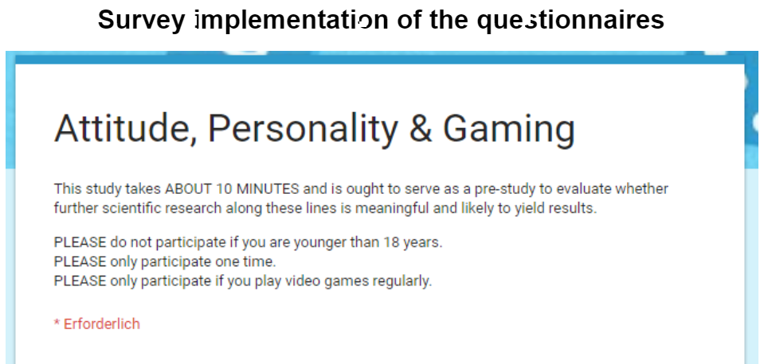
Context of the Data
Survey developed by researchers Marian Sauter and Dejan Draschkow
Survey published to Reddit in 2015, inviting gamers in League of Legends channel to participate
Over 13000 responses recorded

Slide 4
Key Stakeholders to Target
Gamers
Video game developers
Raise awareness of potential links between gaming and mental health, and why they may occur.

Slide 5
Research Questions
On average, how many hours do people spend gaming per week?
Is there a correlation between mental health disorders and amount of time spent gaming?
Is there a relationship between mental health disorder prevalence and different demographics?

Slide 6
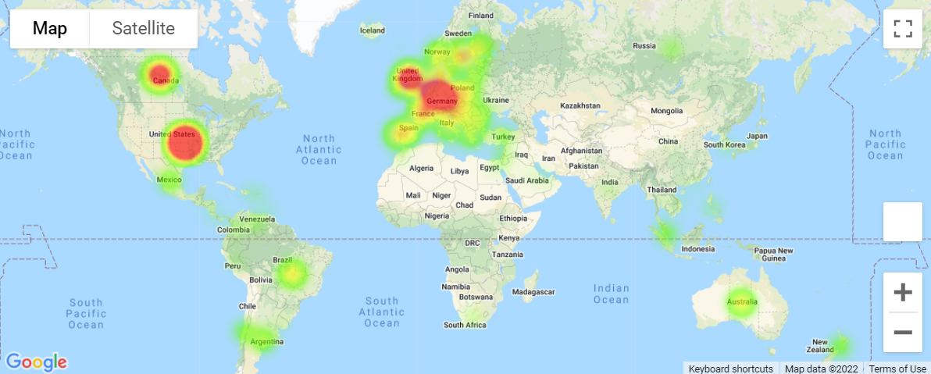
Global Analysis of Participants and Mental Health
Investigated global reach of survey to observe which countries were represented
Majority of participants resided in the United States (n = 4018), Germany (n = 1231), and the United Kingdom (n = 877)

Slide 7
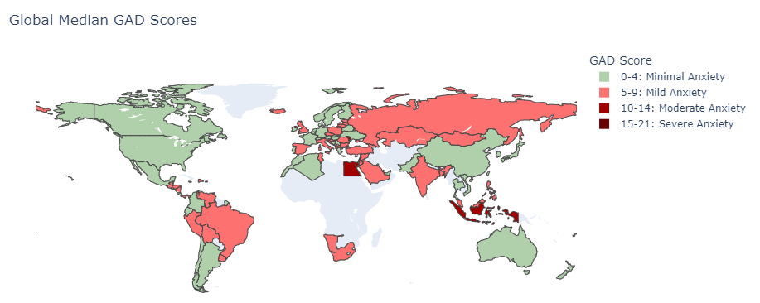
Global Analysis of Participants and Mental Health
Median Generalised Anxiety (GAD-7) Score
Most common Average GAD-7 Score range per country was Mild Anxiety
North American and Oceanic Countries reported lower median GAD-7 Scores compared to Asian and South American countries

Slide 8
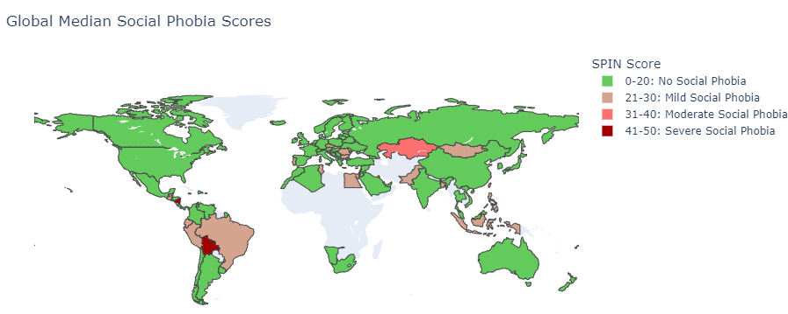
Global Analysis of Participants and Mental Health
Median Social Phobia (SPIN) Score
Majority of countries reported mild to no social phobia

Slide 9
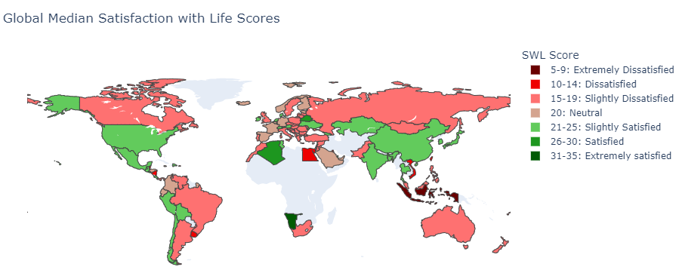
Global Analysis of Participants and Mental Health
Median Satisfaction with Life (SWL) scores
Majority of countries (n = 45) reported slight dissatisfaction with life
Australiasian countries reported lowest SWL scores

Slide 10
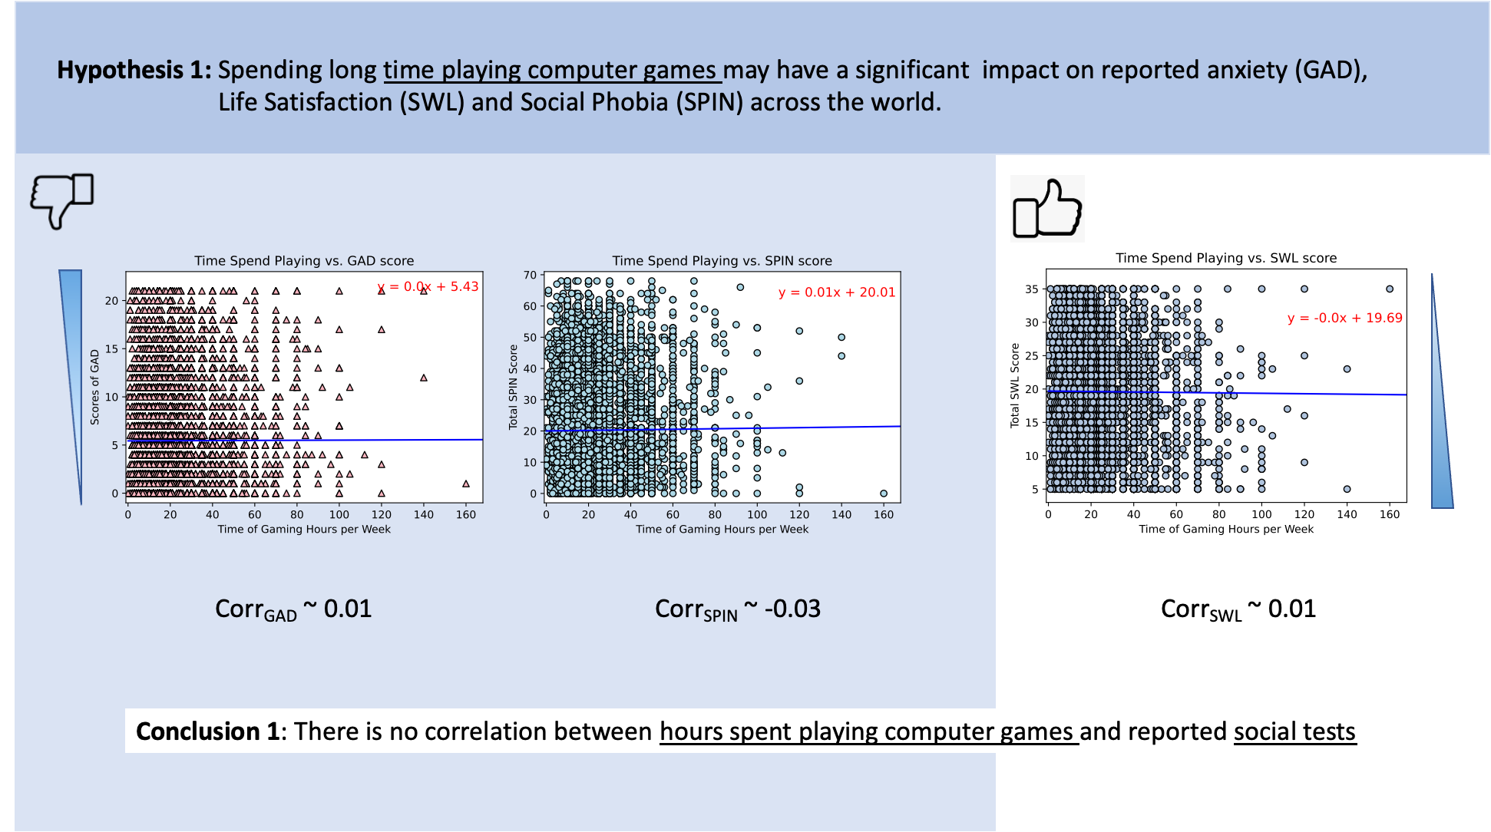

Slide 11
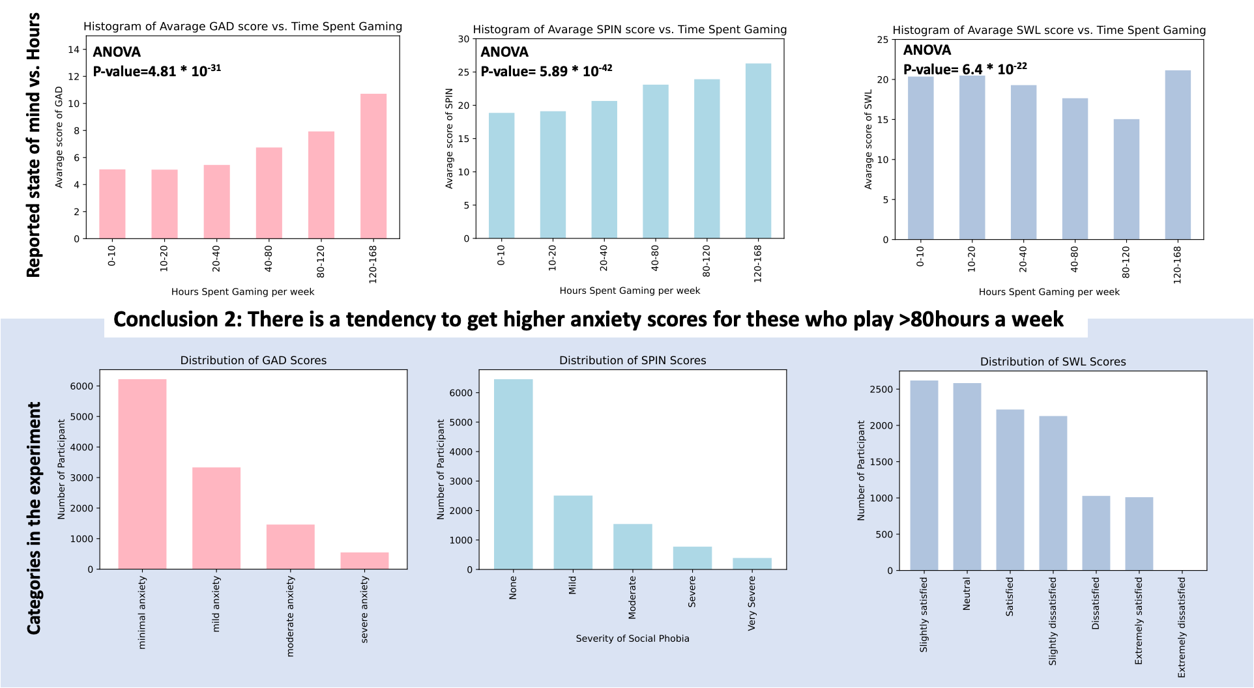

Slide 12
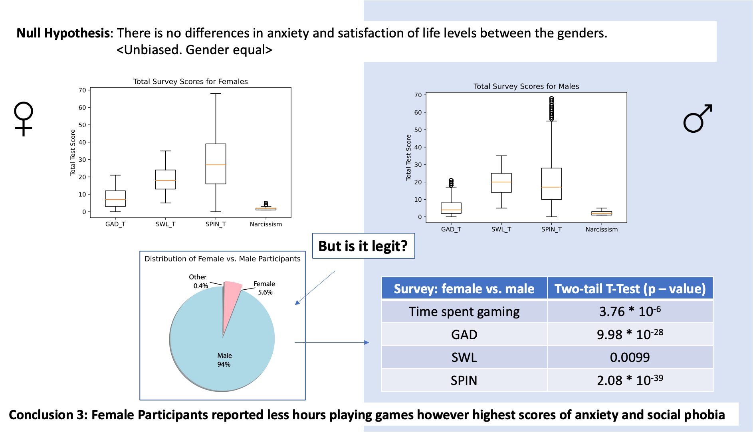

Slide 13
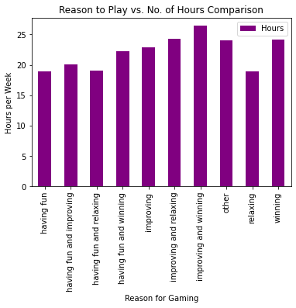
Relationship between Why participants Game, Avg. time spent gaming and Psychological assessment scores
Having fun and relaxing were one of the key options that had low hours of game time compared to others.
The key options provided during the survey to find out why participants continue to game were:
Having Fun (4114)
Improving (3728)
Winning (1602)
Relaxing (530)
Other (133)

Slide 14
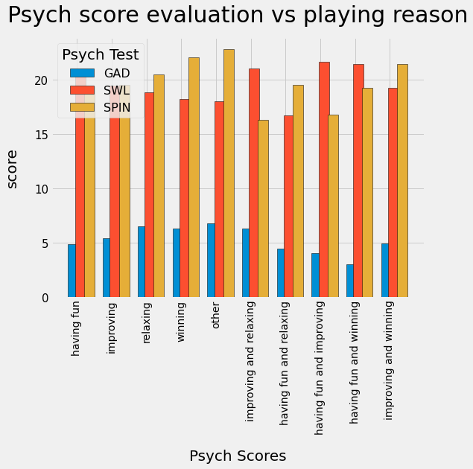
Relationship between Why participants Game, Avg. time spent gaming and Psychological assessment scores
The responses from these categories make the majority of the input. And comparing the GAD, SWL and SPIN scores for each of these showcases that people who only game to have fun have low GAD, SPIN scores and high SWL scores when compared with the rest.
Proving that reason to game plays a key role in how it affects a gamer mentally.
This is also directly relatable with the low number of average hours participants from this group (“Having Fun”) game for in comparison with the rest of the group.

Slide 15
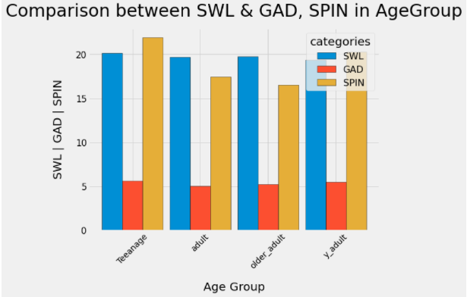
Analysis between SWL & GAD, SPIN in Age Group
From data of survey:
Generalised Anxiety Disorder (GAD): Teenage, Young Adult
Life Satisfaction (SWL): Teenage, Older Adult.
Social Phobia Inventory (SPIN): Teenage & Young adult.
Age range from 18 to 56 years old
Teenage 18-19 y.o
Young adult: 20-24 y.o
Adult: 25-39 y.o
Older adult: 40- 56 y.o

Slide 16
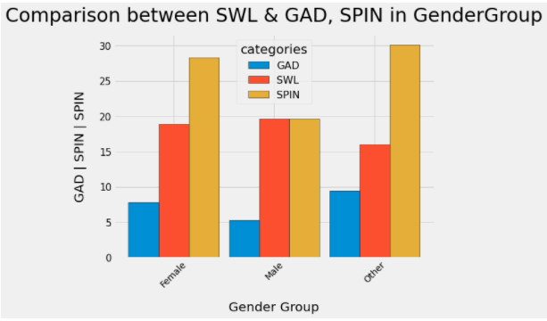
Analysis between SWL & GAD, SPIN in Gender Group
Generalised Anxiety Disorder (GAD): Others & female
Life Satisfaction (SWL): Male, Female
Social Phobia Inventory (SPIN): Others, Female
Female: 653
Male: 10984
Other: 45
Notes:
Cam Slide

Slide 17
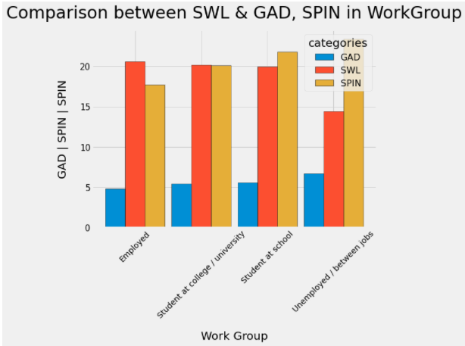
Analysis between SWL & GAD, SPIN in WorkGroup
From data of survey:
Generalised Anxiety Disorder (GAD): Unemployed, Student at school
Life Satisfaction (SWL): Employed, student at college/ uni
Social Phobia Inventory (SPIN): Unemployed, student at school.

Slide 18
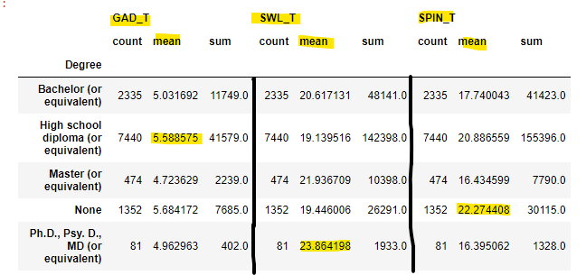
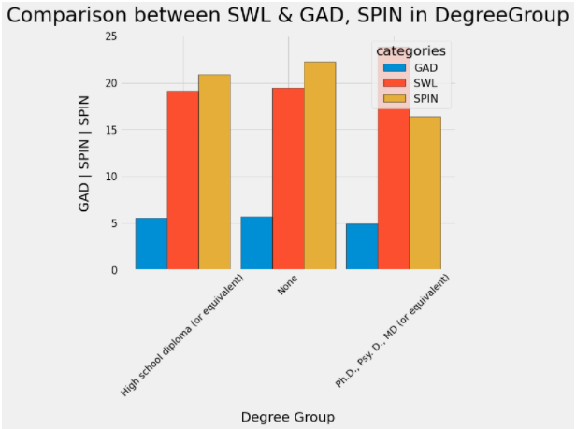
Analysis between SWL & GAD, SPIN in DegreeGroup
Generalised Anxiety Disorder (GAD): High school, No degree.
Life Satisfaction (SWL): Ph.D, Master.
Social Phobia Inventory (SPIN): No degree, high school.

Slide 19
Limitations of the dataset
Heavily biased towards gamers who play particular style of game
Skewed the dataset towards competitive male players
Dataset had too many free text options, making it difficult to analyse
Hard to condense the dataset to be concise and easy to manipulate
Underrepresentation of non-Western countries
Not capturing differences in cultural attitude towards gaming

Slide 20
Actionable Insights
Whilst we observed that those who play games for more hours per week recorded higher anxiety scores, there was no significant correlation between the amount of hours spent gaming and anxiety prevalence
Female gamers reported higher levels of anxiety and social phobia
Action: Further investigation into why this may occur. Provide more support for female gamers in male-dominated games and raise awareness of this gender divide
Reasons why gamers play video games can impact their mental health
Action: provide support for gamers who are playing to earn a living, and use campaigns to promote healthy work/gaming/life balances amongst gamers

